Slide 1
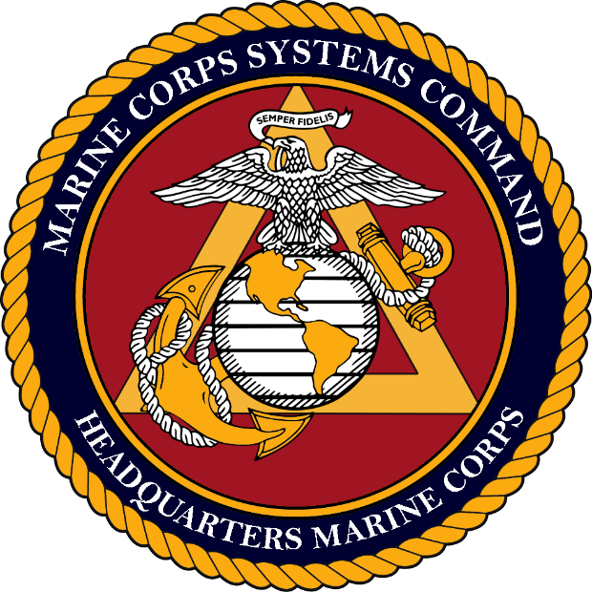
AFCEA
IT DAY
May 27, 2020
BGen A.J. Pasagian
Commander
Marine Corps Systems Command

Slide 2

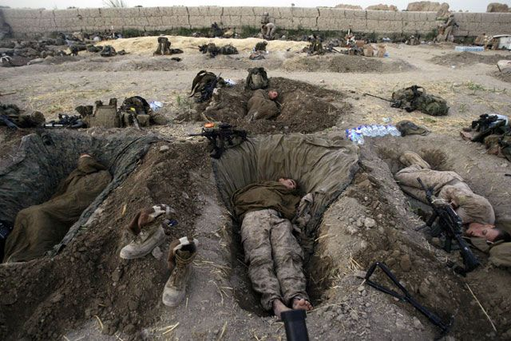
Mission
To serve as the Department of the Navy's systems command for Marine Corps ground weapon and information technology system programs in order to equip and sustain Marine forces with full-spectrum, current and future expeditionary and crisis response capabilities.
Notes:
Marine Corps Systems Command is the acquisition command of the Marine Corps, America’s expeditionary force in readiness.
It is our mission to equip and sustain Marine forces with the most capable and cost-effective ground weapon and information technology systems.

Slide 3
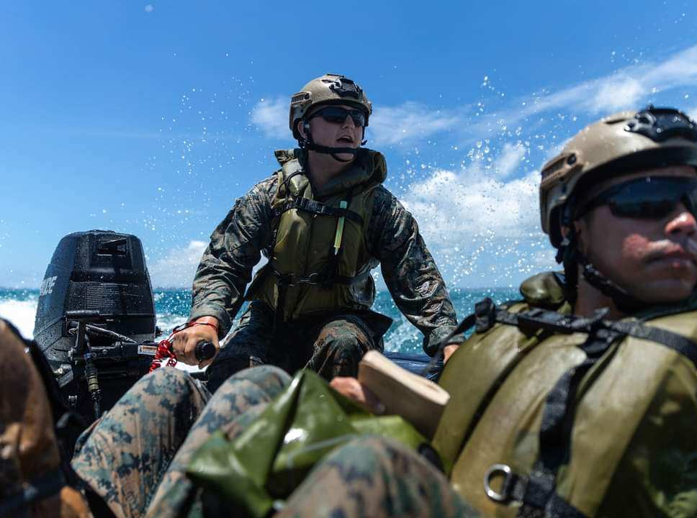
FORCE
DESIGN
2030

Slide 4
ACQUISITION LINES OF EFFORT
Air Defense
  Composite Tracking Network (CTN), Common Aviation Command & Control System (CAC2S),
  Marine Air Defense Integrated System (MADIS), Ground/Air Task Oriented Radar (G/ATOR),
  Air Battle Management (ABM), Medium Range Interceptor Capability (MRIC)
C2 in a Degraded Environment
  Combat Data Network (CDN), Network on the Move (NOTM), TWTS, SCI Communications, Tactical Communications Modernization (TCM), MC2SA, Wideband Satellite Communications, SMART-T, Blue Force Tracker (BFT)
Close Combat Lethality
  OPF-I, Family of Infantry Weapon Systems, Ballistic Protection Systems (BPS), Combat Optics,
  Small Unmanned A/C Systems Family of Systems
Information Warfare
  TENCAP, DCGS-GEOINT, DCGS-All Source, DCGS-SIGINT, CIHEP, Signature Management, IBR, TSCS, IDS-MC, Forensics Dominance Systems
Logistics
  Log Info Systems (GCSS-MC, ELS2, MLS2), Additive Manufacturing, Family of Ultra Light Tactical Vehicles
Long Range Precision Fires
  HIMARS GBASM/GLCM, CLRF, OPF-M, Family of Artillery Munitions (FAM),
  Long Range Unmanned Surface Vessels (LRUSV), Tactical Hand-off System (THS)
Protected Mobility/Enhanced Mobility
  ACV, ARV, JLTV, Electronic Warfare Ground Family of Systems (MEGFoS), MODi Vehicle Power Adapters (MVPA)

Slide 5
Naval/MAGTF alignment
Counsel
International Programs
MARCORSYSCOM
Commander
Executive Director
Sergeant Major
Small Business
AC/S G-1
Admin
Command Safety
Intelligence Liaison Officer
AC/S G-2
Security
Test & Evaluation
AC/S G-4
Facilities, Supply
& Services
CoS
Chief of Staff
AC/S G-6
OCIO
DEPUTY TO THE COMMANDER
Systems Engineering &
Acquisition Logistics
DEPUTY TO THE COMMANDER
Resource
Management
OPAC/LA
Office of Public
Affairs & Comm/
Legislative Affairs
DIRECTOR
G-3/Operations &
Programs
DIRECTOR
Contracts
Staff Sec
DIRECTOR
Systems
Engineering
DIRECTOR
Financial
Management
IG
Inspector
General
DIRECTOR
Acquisition Logistics &
Product Support
DIRECTOR
Human
Capital Management
CO MCTSSA
Marine Corps
Tactical Systems
Support Activity
PfM GCES
Portfolio Manager
Ground Combat
Element Systems
PfM LCES
Portfolio Manager
Logistics Combat
Element Systems
PfM CES
Portfolio Manager
Command Element
Systems
PfM SES
Portfolio Manager
Supporting
Establishment Systems
PM TRASYS
Program Manager
Training Systems
PM LAV
Becomes a DR-PM
Moves to PEO LS
AVTB
Amphibious Vehicle
Test Branch
PM IW
Infantry Weapons
PM ENG SYS
Engineer Systems
PM INTEL
Intelligence Systems
PM NI
Moves to PEO DIGITAL
PM MC Cyber Ops
Marine Corps
Cyber Operations
PM ICE
Infantry Combat
Equipment
PM SUP/MAINT SYS
Supply & Maintenance
Systems
PM C2 SYSTEMS
Command & Control
Systems
PM CS3
PM WGC
Program Manager
Wargaming
Capability
Moves to PEO DIGITAL
PM LRF
Long Range Fires
PM AMMO
Ammunition
PM COMMS
Communications
Systems
PM APPS
PM MHTV
Ammunition
Moves to PEO MLB
TAS moves from PEO LS
PM FSS
Fire Support Systems
PM LTV
Light Tactical Vehicles
Moves from PEO LS
Move - PfM CES
_{OCT 2020}
Notes:
Our PMs are our focus of main effort
We are mission aligned—aligned with the Navy and MAGTF—not acquisition aligned
Focusing non-recurring engineering to our PEO LS
Focusing sustainment of stable product lines at SYSCOM
Leveraging DoN IT with our new structure under Navy PEOs
All of this allows us to reallocate finite resources to where it matters most for Force Design 2030:
New PM, Long-range Fires
Wargaming Center
PM Marine Corps Cyber Ops

Slide 6
Current Organizational Chart
Counsel
International Programs
MARCORSYSCOM
Commander
Executive Director
Sergeant Major
Small Business
AC/S G-1
Admin
Command Safety
Intelligence Liaison Officer
AC/S G-2
Security
Test & Evaluation
AC/S G-4
Facilities, Supply
& Services
DEPUTY TO THE COMMANDER
Systems Engineering &
Acquisition Logistics
DEPUTY TO THE COMMANDER
Resource Management
CoS
Chief of Staff
AC/S G-6
OCIO
OPAC/LA
Office of Public
Affairs & Comm/
Legislative Affairs
DIRECTOR
Task Force Aquila
Cyber Technology Officer
DIRECTOR
Financial Management
DIRECTOR
G-3/Operations
& Programs
DIRECTOR
Contracts
Staff Sec
DIRECTOR
Systems Engineering
DIRECTOR
Human
Capital Management
IG
Inspector
General
DIRECTOR
Acquisition Logistics &
Product Support
CO MCTSSA
Marine Corps
Tactical Systems
Support Activity
PfM GCES
Portfolio Manager
Ground Combat
Element Systems
PfM LCES
Portfolio Manager
Logistics Combat
Element Systems
PfM CES
Portfolio Manager
Command Element
Systems
PM TRASYS
Program Manager
Training Systems
PM MC
Cyber Ops
Marine Corps
Cyber Operations
AVTB
Amphibious Vehicle
Test Branch
PM IW
Infantry Weapons
PM ENG SYS
Engineer Systems
PM COMMS
Communications
Systems
PM MHTV
Medium Heavy
Tactical Vehicles
PM ICE
Infantry Combat
Equipment
PM SUP/MAINT SYS
Supply & Maintenance
Systems
PM INTEL
Intelligence Systems
PM LTV
Light Tactical Vehicles
PM LRF
Long Range Fires
PM AMMO
Ammunition
PM C2 SYSTEMS
Command & Control
Systems
PM FSS
Fire Support Systems
PM WGC
Program Manager
Wargaming Capability
_{FEB 2021}

Slide 7
Marine Corps Ground/IT Acquisition Command and Control
CMC/ASN (RD&A)
MARCORSYSCOM
PEO Digital
PEO Manpower, Logistics
and Business Solutions
PEO Land Systems
PfM MCSES
Portfolio Manager Marine Corps
Supporting Establishment Systems
PM LI2S-MC
Program Manager Logistics
Integrated Information Systems
PfM LCES
Portfolio Manager
Logistics Combat Element Systems
DEPUTY TO THE COMMANDER
Resource
Management
DIR FM | DIR HCM
PM AAA
Program Manager
Advanced Amphibious Assault
PM N&I
Program Manager Network
& Infrastructure
PM APPS
Program Manager Applications
PfM CES
Portfolio Manager
Command Element Systems
DEPUTY TO THE COMMANDER
Systems Engineering &
Acquisition Logistics
DIR SE | DIR ALPS
PM AC2SN
Program Manager
Aviation Command & Control
And Sensor Netting
PM CS3
Program Manager Customer
Support & Strategic Sourcing
PfM GCES
Portfolio Manager
Ground Combat Element Systems
DIRECTOR
Operations & Programs
PM GATOR
Program Manager
Ground/Air Task
Oriented Radar
ASA (AL&T)
PM TRASYS
Program Manager
Training Systems
DIRECTOR
Contracts
JPEO Chem/Bio Defense
PM GBAD
Program Manager
Ground Based Air Defense
JPM P
Protection
PM MCCO
Marine Corps
Cyber Operations
PM LAV
Program Manager
Light Armored Vehicle
CO MCTSSA
Marine Corps Tactical
Systems Support Activity
AVTB
Command
Statutory/Regulatory
_{FEB 2021}
_{10/20/2017}

Slide 8
Realignment Benefits
USMC Modernization for Global Competition / Value is the Future Operating Environment
Naval Integration
Benefits of Naval Alignment
Preserving USMC/Service Authorities
Maintaining the Competitive Advantage

Slide 9
Upcoming Speakers
Colonel Bailey, Portfolio Manager Command Element Systems
Gaurang R. Dävé, Director, Task Force Aquila
Kyle Beagle, Director of the Office of Small Business Programs
Johany Deal, Director of Contacts

Slide 10


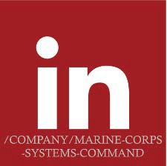




QUESTIONS?
MARINE CORPS SYSTEMS COMMAND
Equipping our MARINES
CONTACT US
Marine Corps Systems Command MCSCPAO@usmc.mil 703.432.3958
MCSC Office of Small Business Programs
MCSCOSBP@usmc.mil 703.432.3946 & 703.432.3944
17

