Slide 1
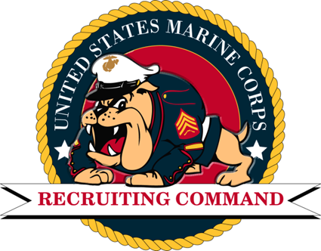
Recruiting and Preparing the Future Force
AFCEA Luncheon
03 June 2021 2021
MajGen Jason Q. Bohm
Dave DiEugenio

Slide 2
AGENDA
Senior Leaders Perspective
Mission
Command Organization & Relationships
MCRC Network Overview
Recruiting Process
Formula for Success
Generation Z and Future Talent
Modernization / Retention

Slide 3
SENIOR LEADERS’ PERSPECTIVE
“Recruiting is where it all begins – in the schools and on the streets of our nation. As we face the next decade, we cannot forget this axiom. We have proved time and again that our recruit training, good as it is, cannot turn unintelligent, poorly motivated, physical wrecks into Marines. Recruiting high-quality applicants for the Corps is terribly expensive, but the price of not doing it is disaster. Fine young men and women can be recruited only by good Marines. We must be able to bear the pain of having to do without our best and brightest while they serve a tour on recruiting duty. Otherwise, we mortgage our future, with bankruptcy an eventual certainty.” -General Walt Boomer, former CO 4th MCD, later ACMC
“From one who has been “dipped in the boiling oil” of recruiting, a couple of views and recommendations. The recruiting machinery is the most sensitive of any organization we have. Mal-adjust it, and the results are traumatic – and long-lasting. In the past, it’s been tampered with from time to time – always with well-intended management as a goal – and in most cases, the results have been predictable: quality production declines… A couple of years ago, when we took down the recruiting force by a couple hundred, the results were predicable – and they occurred precisely as those close to recruiting would have predicted. “ -LtGen C.E. Mundy to CMC General Gray

Slide 4
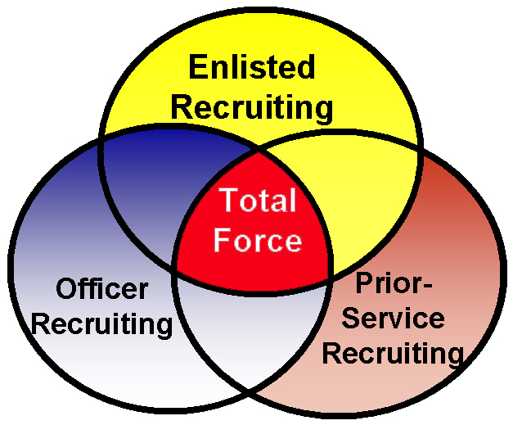
MISSION STATEMENT
Marine Corps Recruiting Command is responsible to the Commandant of the Marine Corps for the procurement of qualified individuals, to meet established personnel and strength levels, officer and enlisted, of the Marine Corps and Marine Corps Reserve.

Slide 5
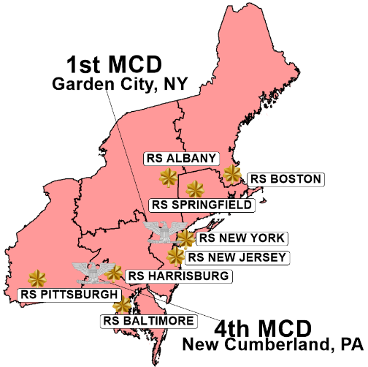
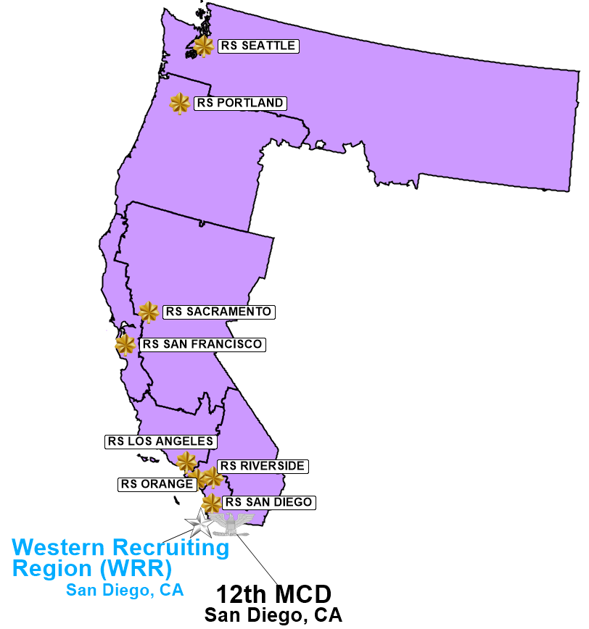
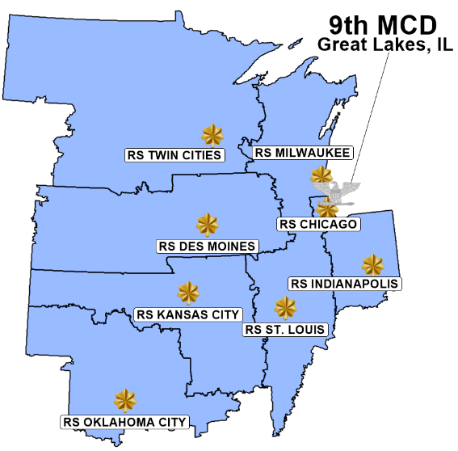
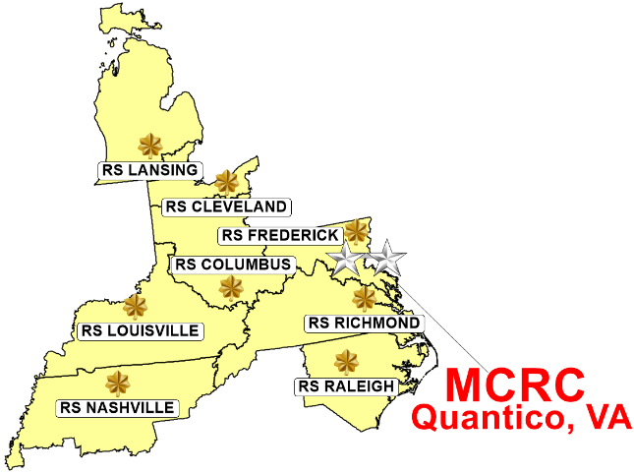
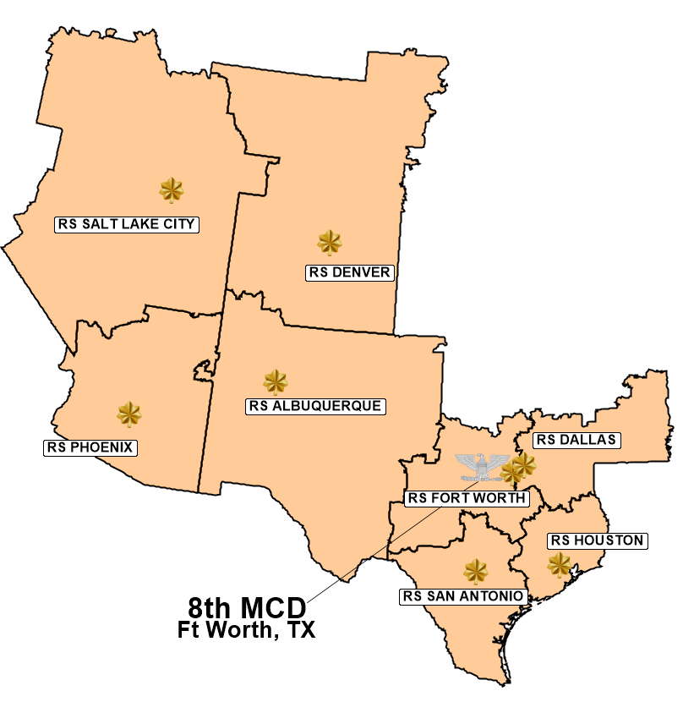
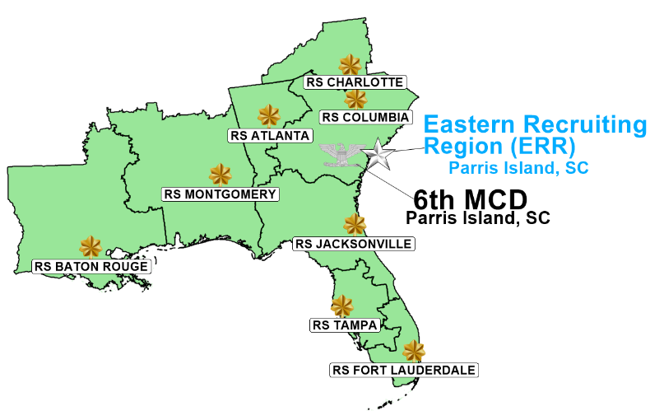
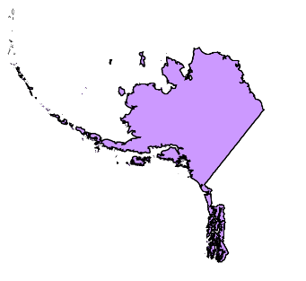
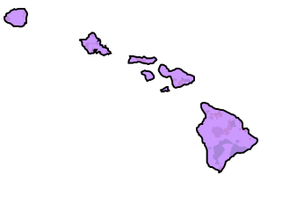
Facilities: 1491
Vehicles: 3645
Personnel: 3763
Operational Environment
“Distributed Operations”
Okinawa
Germany (RS Boston)
Guam (RS San Diego)
American Samoa (RS San Diego)
2 Regions
6 Districts
48 RSs/6PSRs
74 OSSs
589 RSSs/20PSRSSs
761 PCSs/39 PSPCSs
Puerto Rico (RS Ft Lauderdale)
US Virgin Islands (RS Ft Lauderdale)
Alaska (RS Portland)
Hawaii (RS San Diego)
Notes:
Recent Cmd Climate Survey:
--Recruiter comments; safety concerns related to extensive driving requirements, trust within recruiting commands, and incentives for new recruits.
--MCRC implemented video-based telematics to proactively improve the habits of every driver.
--The staffing and manning of the recruiting force and advertising funding are the primary ways to reduce windshield time for an individual recruiter.
--Insufficient funding risks standard levels of in-person leadership and support, which is critical for the systematic recruiting process. Reduced command training and presence results in reduced effectiveness and increased stress on the force.
In FY18, the number of miles driven was 45,364,996. The number of accidents was 256 (This accounts for all types of accidents, e.g. animal strikes). The total cost of those accidents was $1,088,141.70.
3,763 is our 8411 and 8412 population only. There are approximately 6,000 personnel in MCRC. 6,000 includes 8411, 8412 and support personnel.
We are covering every zip code. The Navy is sectioning off “virtual areas” without recruiters.
Add quad-slide to compare accessions across services
Add “OCONUS” box to slide.

Slide 6
CMC
Entry Level Training TECOM
MCRC Advocate M&RA
Mans the Force
CD & I
Builds Force Structure
Levies accession requirements on MCRC
MajGen Bohm
MCRD/ERR/BASE
BGen Nethercot
MCRD/WRR/BASE
BGen Heritage
”
SgtMaj Brown
SgtMaj Carter
SgtMaj leal
1st MCD
Col Ash
4th MCD
Col Cotoia
6th MCD
Col Gray
8th MCD
Col Sanchez
9th MCD
Col Morales
12th MCD
Col Conway
SgtMaj Orjuela
SgtMaj Kuss
SgtMaj Banks
SgtMaj Jerome
SgtMaj Upp
SgtMaj Murcia
48 Recruiting Stations
74
OSOs
65
MEPS
6 PSR Stations

Slide 7
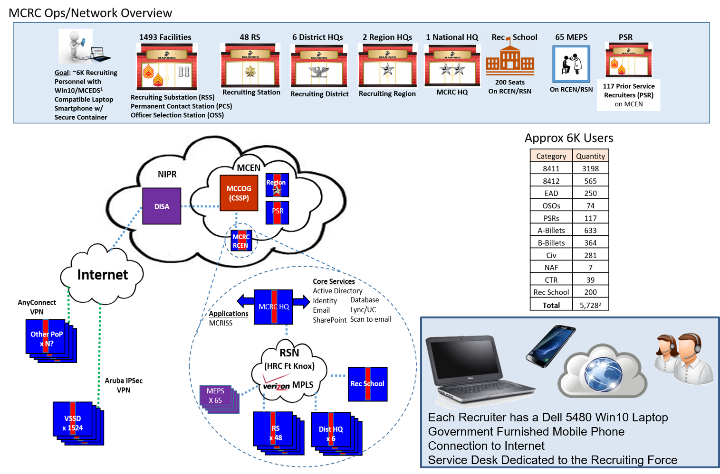
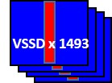
275 Seat Classroom on RCEN
147 Prior Service Recruiters (PSR)
SW VPN
Corona Virus Response:
Maximizing I-C4 Approved Resources
LAN/WAN Capacity Management
VPN Capacity Management
Sustaining CSSP relationships
Compliance
Situational Awareness
Speed of Response
HW VPN
5

Slide 8
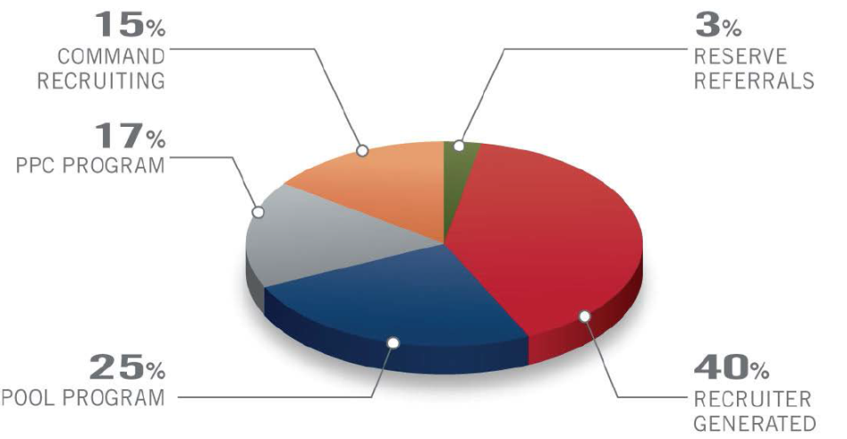
Recruiting Process
THE ENLISTED RECRUITING PROCESS
NEW CONTRACT SOURCE GOALS
Obtaining Names
Prospecting
Screening
Selling
Processing
Pool Program
Shipping
Command Recruiting
Notes:
8
Systematic Recruiting is an organized, well thought out approach for recruiters to go about performing the actions necessary to achieve assigned shipping, contracting, and quality missions.
There are four major enlisted recruiting programs:
• Command Recruiting Program
• High School/Community College (HS/CC) Program
• Pool Program
• Priority Prospect Card (PPC) Program
These programs contribute directly to the achievement of enlisted recruiting missions. The success of these programs will, to a great extent, determine the overall success of your Recruiting Station (RS). In addition to the major recruiting programs there are other, subordinate or related, programs, which, although not as critical as the four major programs, make significant contributions to the RS recruiting effort.
Naval Reserve Officers Training Corps (NROTC) Program.
Reserve Referral Program.
c. DoD Student Testing Program (ASVAB).
d. Certificate Awards Program.
e. Mail out Program.
g. Recruiter Aide Program.
Extended Active Duty (EAD) Recruiter Program.
Programs contribute significantly to the ability to make assigned missions. The pie chart represents new contract source goals based on programs goals.

Slide 9
USMC Formula for Success
38th Commandant’s Planning Guidance, Force Design, People, Page 6: “Marines are the centerpiece of the Corps-our principal emphasis must focus on recruiting…”
Quality Recruiting Force
Mission Success (High Quality People)
Systematic Recruiting
Funding: Advertising & Rec Ops
Institutional Investment
Excepted Cmd (3763 T/O)
RSCO Selection (top 4%)
Company Grade Panel
48 RS SgtsMaj
SDA Screening Process (RtR)
8412 Career Recruiters
PSR Selection + 8421 Staffing
35% Ground G.O.’s w/ Recruiting Experience
Doctrine
Policy
Components
Programs (HS/CC)
Formal School
Monthly Proficiency Training
Accountability
Awareness/Media
Lead Generation
Recruiter Sales Support
Canvassing Events
Vehicles
Cell Phones
Civilian Labor
TAD/Travel
99.5% HS grads
70% I-III A
0% Cat IV
MCRD /NEAS Attrition
Officer Quality
Diversity Gains (34% Officer, 43% Enlisted)
Female Increases (AC: 13% Officer, 10% Enlisted - COVID)
Low Attrition, High Quality, Diverse Force
Notes:
P&R Note:
The Marine Corps’ formula for success is a three-pronged approach to achieving the desired outcome for recruiting. The three prongs are a quality recruiting force, systematic recruiting, and funding -- advertising and recruiting operations -- to result in mission success (high quality people).
The institutional commitment to ensure a quality force utilizes a number of measures to ensure the most qualified Marines are selected at all levels of recruiting. The command selection board for RS commanding officers reviews the records of the top 400 majors of the 3,875 active duty majors to select approximately 15 RS COs every year. The most important element is that this board selects before any of the other boards and therefore has access to every eligible major. The headquarters Marine Corps special duty screening team (HSST) screening, likewise has first access to every corporal, sergeant, and staff sergeant each year as it works to sustain. The HSST visits commands around the Marine Corps to personally screen each individual.
The goal of systematic recruiting is to organize the recruiter's efforts so that the required contacts, appointments, interviews, New Working Applicant (NWA), and contracts are achieved. These goals extend to managing the pool and conducting an effective Command Recruiting (CDR) program. Systematic recruiting is also designed to leverage supporting assets such as the High School/Community College (HS/CC) Program and Media Program to achieve consistent quality results by increasing awareness of Marine Corps opportunities. Systematic recruiting assists the recruiter and Staff Noncommissioned Officer In Charge (SNCOIC) in developing effective annual and monthly plans, plus weekly and daily schedules. Systematic recruiting focuses the efforts of both the recruiter and SNCOIC on those activities and programs that are vital to effective recruiting.
MCRC’s funding comprises Recruiting operations and Advertising. Recruiting Operations funding relates specifically to the recruiter’s mission, to include use of vehicles, cell phones, and reimbursements for TAD/travel. Advertising funding is anything directly related to making the Marine Corps known to the public, including paper and digital media formats to public events.
Combing all three ensures mission success. The acquisition of high quality people into the Marine Corps is the result of the strength of each piece of the formula. Mission success has obvious secondary and tertiary effects, comprised of lower attrition rates at recruit and entry-level training, and increased quality accessions.

Slide 10
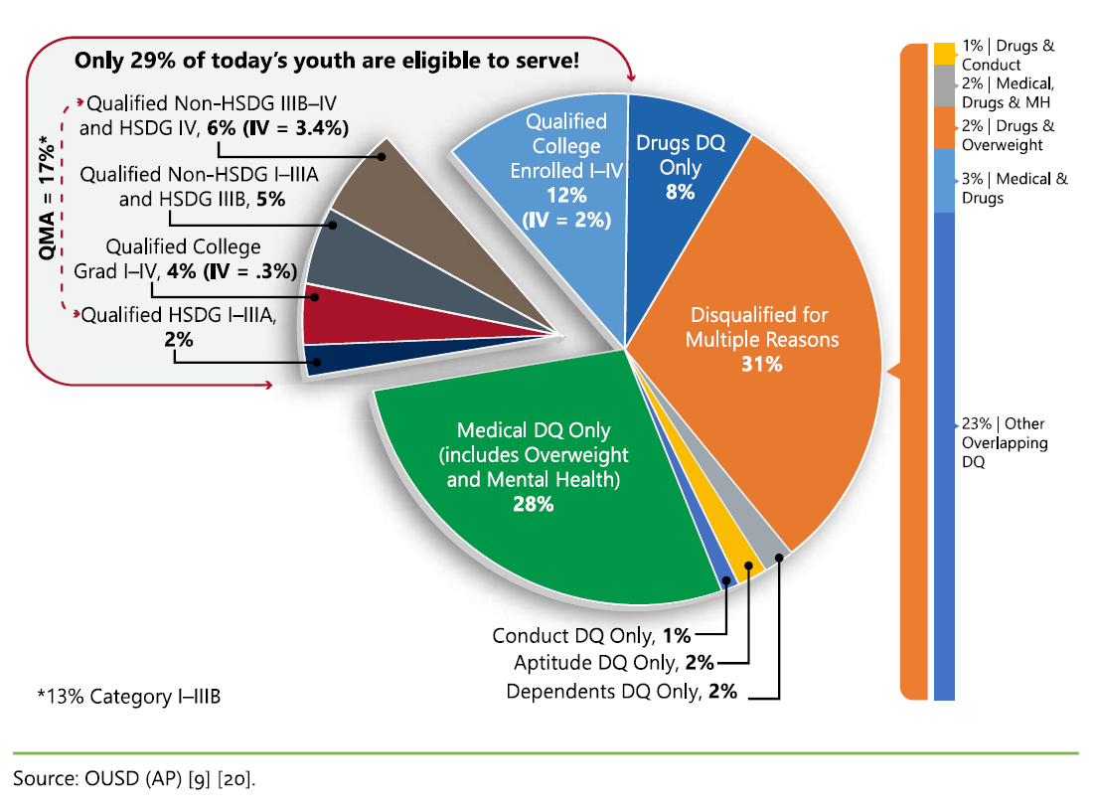
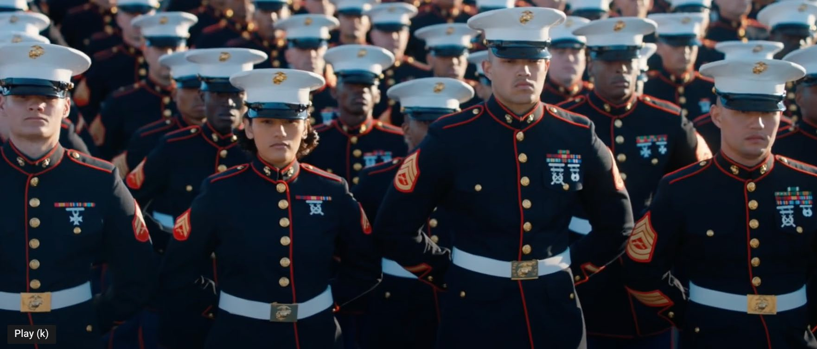
State of the Market: Gen Z and Beyond
Youth-Market Eligibility
Gen Z Attributes
Challenge “American exceptionalism;” declining interest in military as a career option.
Exhibit strong views of diversity and inclusiveness; women are ascending to lead across all public and private sectors.
Seek participation in causes they deem worthy (climate change, social equality, etc.), but spurn hierarchies.
Don’t align with military challenges posed in NDS or “Great Power Competition.”
USMC Target Market:
7% of Eligible Youth
Strong belief robotics/ drones/ AI will perform future warfighting functions.
“Connected Loneliness” experienced by coupling tech/social media with culture of radical individualism, resulting in social alienation and elevated depression.
Risk averse; expanded adolescence and are willing to defer adulthood into mid-late 20’s.
Place a premium on relationships with peers, parents, and influencers in decision-making.
In-roads to Gen Z can be made by emphasizing the Marine Corps’ intangibles:
teamwork, commitment, purpose, and belonging in pursuit of a common cause

Slide 11
Accession Talent The Raw Material of the Future 21st Century Warfighter
Applicant Attributes
21st Century Warfighters
Physical Tenacity
Competitive Spirit
Memory
Processing Speed
Pattern recognition
Problem Solving
Flexibility
Adaptability
“Elite warriors with physical and mental toughness, tenacity, initiative, and aggressiveness to innovate, adapt, and win in a rapidly changing operating environment.” -CPG
Pool Development
T&E Pipeline
Leadership
Experience
2030 Marine

Slide 12
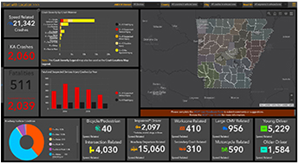
MCRC Modernization
Quality Recruiting Force
Mission Success (High Quality People)
Systematic Recruiting
Funding: Advertising & Rec Ops
Transition Highest Quality Marines to RC
Find & Attract
- Modernize prospecting, IT, and performance with AI / ML, cognitive gaming, mobile apps, and augmented reality
- Recruit the Recruiter Campaign
- Digital Marketing
- Cognitive Assessments
- Analytics & Predictive Analysis – MCOSM (align interests / skills to MOS), ESM, RPN
- Integrated Applications & Enhanced VR tools – Squad Bay, Battle Position
- MCRISS II – Cloud based, multi system integration, automates systematic recruiting functions
- GeoFidelis Mapping –Workflows for territories, location-allocation, and market/program penetration analysis
Pool Development
- Accelerate maturity & the transformation process – prepare poolees to succeed as future Marines
- Civics – Oath of Office, Values Based Training, Core Values, Code of Conduct
- Cognitive Skills - Develop Intellectual Edge – Memory, Processing, Patterns, Flexibility
- Scientifically-validated games tailored to individuals
- Competition - Develop competitive mindset against oneself and others
- Retention – Benefits of service, MCOSM, Service after the sale
2030 Marine
Access to Retain
Recruit to Retain the Most Talented
- Continue to Exceed Quality Standards
- Talent Attributes
- Accelerate Maturity – Pool Development
- MOS satisfaction
- Lower MCRD / NEAS Attrition
- Improved ELT performance
- High Quality Marines
Enterprise Effort
- Total Force brand and advertising
- Career Planner POI & Systematic Retention tools
- Data sharing between MM, Career Planners, and
Prior Service Recruiters = lead generation
- Marine lifecycle data management / analytics
- Transition AC to RC (Direct Affiliation Program)
Notes:
P&R Note:
The Marine Corps’ formula for success is a three-pronged approach to achieving the desired outcome for recruiting. The three prongs are a quality recruiting force, systematic recruiting, and funding -- advertising and recruiting operations -- to result in mission success (high quality people).
The institutional commitment to ensure a quality force utilizes a number of measures to ensure the most qualified Marines are selected at all levels of recruiting. The command selection board for RS commanding officers reviews the records of the top 400 majors of the 3,875 active duty majors to select approximately 15 RS COs every year. The most important element is that this board selects before any of the other boards and therefore has access to every eligible major. The headquarters Marine Corps special duty screening team (HSST) screening, likewise has first access to every corporal, sergeant, and staff sergeant each year as it works to sustain. The HSST visits commands around the Marine Corps to personally screen each individual.
The goal of systematic recruiting is to organize the recruiter's efforts so that the required contacts, appointments, interviews, New Working Applicant (NWA), and contracts are achieved. These goals extend to managing the pool and conducting an effective Command Recruiting (CDR) program. Systematic recruiting is also designed to leverage supporting assets such as the High School/Community College (HS/CC) Program and Media Program to achieve consistent quality results by increasing awareness of Marine Corps opportunities. Systematic recruiting assists the recruiter and Staff Noncommissioned Officer In Charge (SNCOIC) in developing effective annual and monthly plans, plus weekly and daily schedules. Systematic recruiting focuses the efforts of both the recruiter and SNCOIC on those activities and programs that are vital to effective recruiting.
MCRC’s funding comprises Recruiting operations and Advertising. Recruiting Operations funding relates specifically to the recruiter’s mission, to include use of vehicles, cell phones, and reimbursements for TAD/travel. Advertising funding is anything directly related to making the Marine Corps known to the public, including paper and digital media formats to public events.
Combing all three ensures mission success. The acquisition of high quality people into the Marine Corps is the result of the strength of each piece of the formula. Mission success has obvious secondary and tertiary effects, comprised of lower attrition rates at recruit and entry-level training, and increased quality accessions.

Slide 13
Questions/Discussion

